Slide 1
Synchronization Examples Lesson 3 POSIX Synchronization
David Liu
2021

Slide 2
Learning Outcomes
User level APIs for UNIX, Linux, and macOS
POSIX mutex locks, semaphores
POSIX condition variables

Slide 3
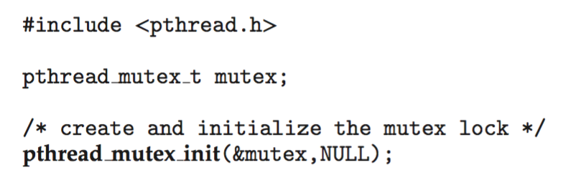
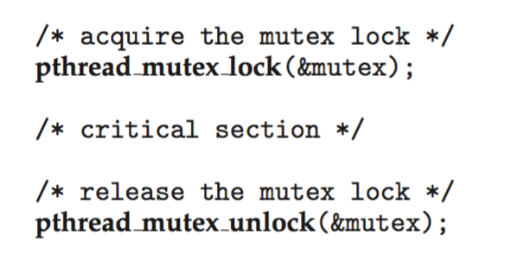
POSIX Mutex Locks
Creating and initializing the lock
Acquiring and releasing the lock

Slide 4
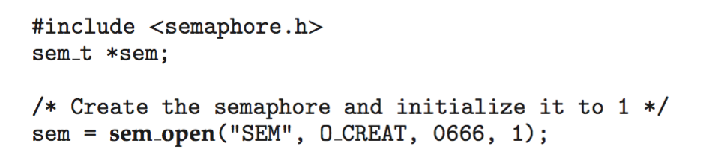
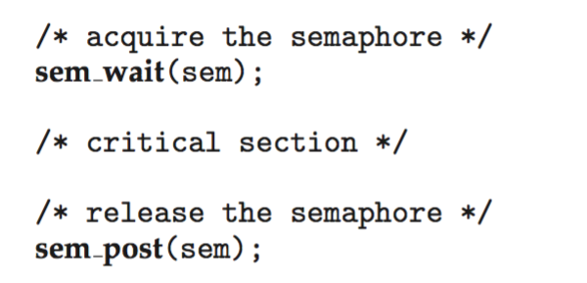
POSIX Named Semaphores
Creating an initializing the semaphore:
Acquiring and releasing the semaphore:

Slide 5
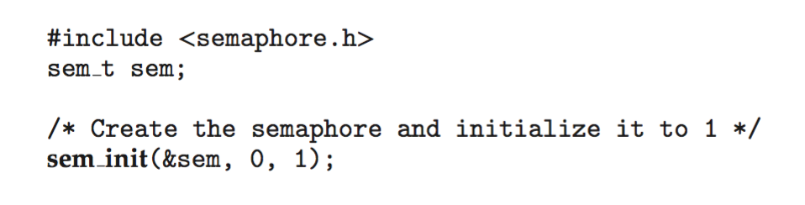
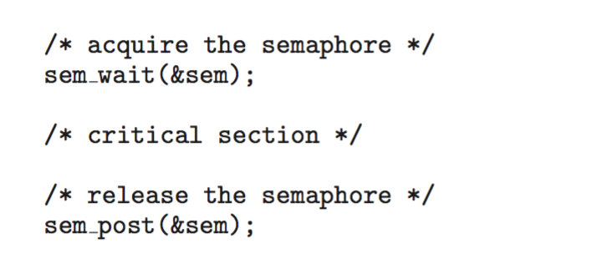
POSIX Unnamed Semaphores (1)
Creating an initializing the semaphore:
Acquiring and releasing the semaphore:

Slide 6
POSIX Unnamed Semaphores (2)
Int semi_int(sem_t *sem, int pshared, unsigned int value);
pshared:
Non-zero: shared between processes
Zero: shared between threads of the process
return:
-1: failed.

Slide 7
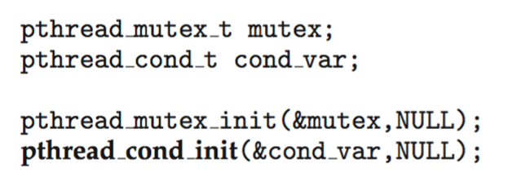
POSIX Condition Variables
Similar to condition variables in a monitor
Associate with a POSIX mutex lock to provide monitor like services in C/C++

Slide 8
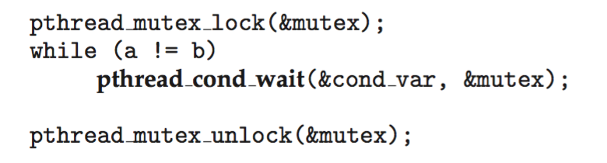
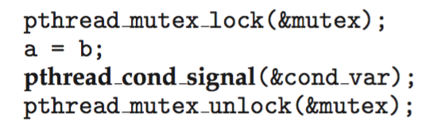
POSIX Condition Variables
A thread waiting for the condition a == b to become true:
Another thread signaling a thread waiting on the condition variable:
1. Release the mutex lock
2. Wait on both condition variable & mutex

Slide 9
POSIX Condition Variables
Process P₀ waits on
condition cond (eg. a == b)
a = 5; b = 4;
P0 acquires mutex (0)
a == b false, P₀ release mutex (1) and waits on condition variable con_var & mutex
P0 is off cond_var queue & waits on mutex
P0 acquires mutex and check condition a == b
Process P₁ may affect
condition cond (e.g. a == b)
P₁ acquires mutex (0)
b = 5
P₁ signal P₀ from con_var waiting queue
P1 release mutex

